Slide 1
NIH Salary cap over-the-cap support
Quarterly DGA meeting
6.11.2019

Slide 2
Ovpri nih salary cap support
RDS
SPS
RFBA

Slide 3
Research development services
rds.uoregon.edu

Slide 4
NIH over the cap policy
Navigate in the side menu to NIH Salary Cap Policy

Slide 6
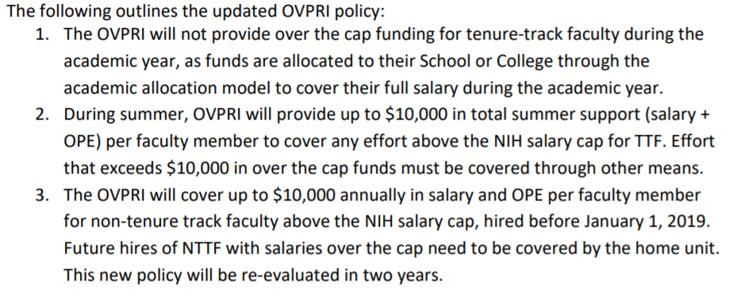

Slide 7
Sponsored projects services
Unit Gathers Salary Cap Data
Submits Request to Post Team

Slide 8
Research finance & business administration
Cap
Award
Amounts
SPS Review
Submit to RFBA
Review
Process Transfer

Slide 9
Nuts and bolts
Process will be posted to the RDS website
Finalizing a request spreadsheet; will also be posted on the RDS website
Reimbursement requests can be made annually or semi-annually

Slide 10
Questions?

