Slide 1
Sponsored Research, International Collaborations & Export Control Regulations for DGAs & PIs
June 2024
Notes:
Mandy

Slide 2
Overview
Overview
Export Control Regulations and the Fundamental Research Exclusion
Changing Landscape
Implications for PIs and DGAs
Notes:
Mandy

Slide 3
Export Controls 101
Export Controls are informed by a variety of federal regulations and laws which control what commodities, software, technologies, and services may be disclosed to foreign nationals or exported to foreign locations.
Export Control Officer (ECO) monitors all areas of foreign engagement at UO and manages compliance with federal regulations under Commerce, State and Treasury which govern the export of regulated commodities, software and information.
Types of control vary greatly, incl. individuals and entities on restricted lists, and equipment and chemicals which are subject to specific controls by nationality or within specific country.
Export license requirements are rare, but when needed, ECO handles them. Licenses can be required for both physical and non-tangible “deemed” exports.
ECO is notified when EPCS record includes foreign collaborator or funding source.
ECO reviews record to complete necessary compliance checks and to verify that Fundamental Research Exclusion applies.
Notes:
Ethan

Slide 4
Fundamental Research Exclusion (FRE)
Research and scholarly activity which will be published, publicly available or in the public domain and which is not subject to restrictions or confidentiality clauses, or proprietary in nature.
Creates exclusion for non-tangible research results only, conducted in the US. Equipment and information used during research can still be controlled.
Physical items are always subject to export controls, incl. shipments and on-campus access to equipment. Items/equipment used during FRE-qualifying research may still be controlled.
FRE does not apply to research involving proprietary information or confidentiality clauses, or subject to national security restrictions.
FRE does not apply if sponsor places nationality or publication restrictions on research (specific limited pre-publication review OK).
If research activity qualifies for FRE but involves proprietary information from a sponsor, that specific information is still subject to export controls.
FRE does not apply to activity involving embargoed or comprehensively sanctioned countries.
When FRE does not apply, ECO determines whether any aspect of research is subject to export controls and/or whether foreign party is subject to export restrictions. Deemed exports are key consideration when FRE is nullified.
FRE nullification increases likelihood of license requirement. ECO handles when necessary.
Notes:
Ethan

Slide 5
Changing Landscape: NSPM-33 & CHIPS and Science Act
UO must develop Research Security Program
Have 1 year from final implementation guidance to comply, but UO is taking steps to prepare
Implementation guidance has yet to be issued
Program must include elements of cybersecurity, foreign travel security, insider threat awareness and identification, and export control training.
New training required for PIs, senior personnel, and key personnel
Report allegations of research security non-compliance via Ethics Point
Details on other components of research security program will be posted on exportcontrols.uoregon.edu
Notes:
Mandy

Slide 6
Changing Landscape: Required Training
Research Security Training
Who: PIs, key personnel, senior personnel
How: CITI’s “Undue Influence: Foreign Risks & Mitigations”
Time Commitment: 1 ½ hours
Frequency: Annual
**This Information May Change**
Export Control Training
Who: PIs, key personnel, senior personnel if export control restrictions on a federally funded research and development award
How: CITI’s Export Compliance Course
Time Commitment: ½ hour
Frequency: Unclear
**This Information May Change**
Foreign Travel Security Training
Who: “Relevant personnel” if foreign travel on award
How: Uncertain at this time; could be via CITI, may be through Concur
Time Commitment: Uncertain at this time
Frequency: Uncertain at this time
**This Information May Change**
Notes:
Mandy

Slide 7
Changing Landscape: Foreign Travel
Continuing Requirements (Not New) | Upcoming Requirements
Covered foreign travel must be compliant w/ sponsor requirements and approved by sponsor UO will need to keep record of travel via Concur | Foreign travel policy forthcoming. Will include: advance disclosure, security briefings, device security, pre-registration Researchers traveling need to complete training and security briefing. ECO review to be sure license isn’t required. Discussion about applying for one if it is. May need loaner laptop depending on travel destination
Notes:
Ethan

Slide 8
Changing Landscape: Disclosures
New standardized disclosure requirements and forms across agencies as result of presidential directive
UO required to annually disclose researchers' external commitments to funding agencies.
UO required to notify funding agency within 30 days of any disclosure failure.
Notes:
Mandy

Slide 9
Changing Landscape: Disclosures
In current/pending support document and biosketch, PIs must disclose:
Organizational affiliations and employment
External positions and appointments
Foreign government-sponsored talent recruitment programs
Honorary titles, degrees, and lab space at other institutions, especially if foreign
Even if there is no monetary value
Disclosures must match what is reported annually to Conflict of Interest Office via Research Administration Portal
What’s often missed: Honorific titles, unpaid appointments, unpaid board service, outside activities generating <$5,000/year since they may not be subject to UO’s Financial Conflict of Interest in Research Policy
When in doubt, disclose, disclose, disclose!
Places burden of compliance on institution rather than researcher
Notes:
Mandy

Slide 10
Changing Landscape: Malign Foreign Talent Recruitment Program (MFTRP)
MFTRP is recruitment program sponsored by or located in country of concern which offers compensation for problematic obligation or activity.
Countries of concern include: China, Iran, North Korea, Russia, and others
Problematic Obligations/Activities | Compensation
Unauthorized transfer or sharing of intellectual property, data, or materials Employment in foreign country in violation of federal award terms Signing a contract or agreement with termination restrictions Unspecified time commitment to foreign institution Requirement to withhold disclosure from UO or U.S. government | Cash Research funding Promise of future compensation Paid foreign travel Honorific titles Career advancement opportunities Lab/research space Other things of de minimis value
Notes:
Ethan

Slide 11
Changing Landscape: Malign Foreign Talent Recruitment Program (MFTRP)
UO researchers cannot participate in MFTRPs.
Legitimate FTRPs are OK: legitimate purpose of attracting talent by offering grants and fellowships to incentivize physical relocation.
Export Control Officer is available to review FTRPs for compliance. Email exportcontrols@uoregon.edu
Annual disclosures must include applications to, or pending or current support of, FTRPs.
Notes:
Ethan

Slide 12
Changing Landscape: Digital Persistent Identifier (DPI)
Researchers supported by federal grants required to be registered with service which provides DPI.
DPIs will be integrated into new federal disclosure processes.
Open Research & Contributor ID (ORCID) offered free of charge.
Digital record/CV that includes info about appointments, publications, data, education.
Must be congruent with biosketch and COI disclosure.
Some faculty currently have ORCID.
Notes:
Just touch on given time constraints
Mandy

Slide 13
Changing Landscape: Cybersecurity
Requirements include: Regular cybersecurity awareness trainings, limit information system access to authorized users and uses, control non-public info on publicly-accessible systems, provide protection from malicious code, and more.
Most requirements currently in effect or implemented via background infrastructure led by UO Information Security Office (ISO).
Export controls can assist with Risk Mitigation Plans that may be required at proposal stage.
Risk Mitigation Plan template forthcoming.
Notes:
Just touch on given time constraints
Mandy

Slide 14
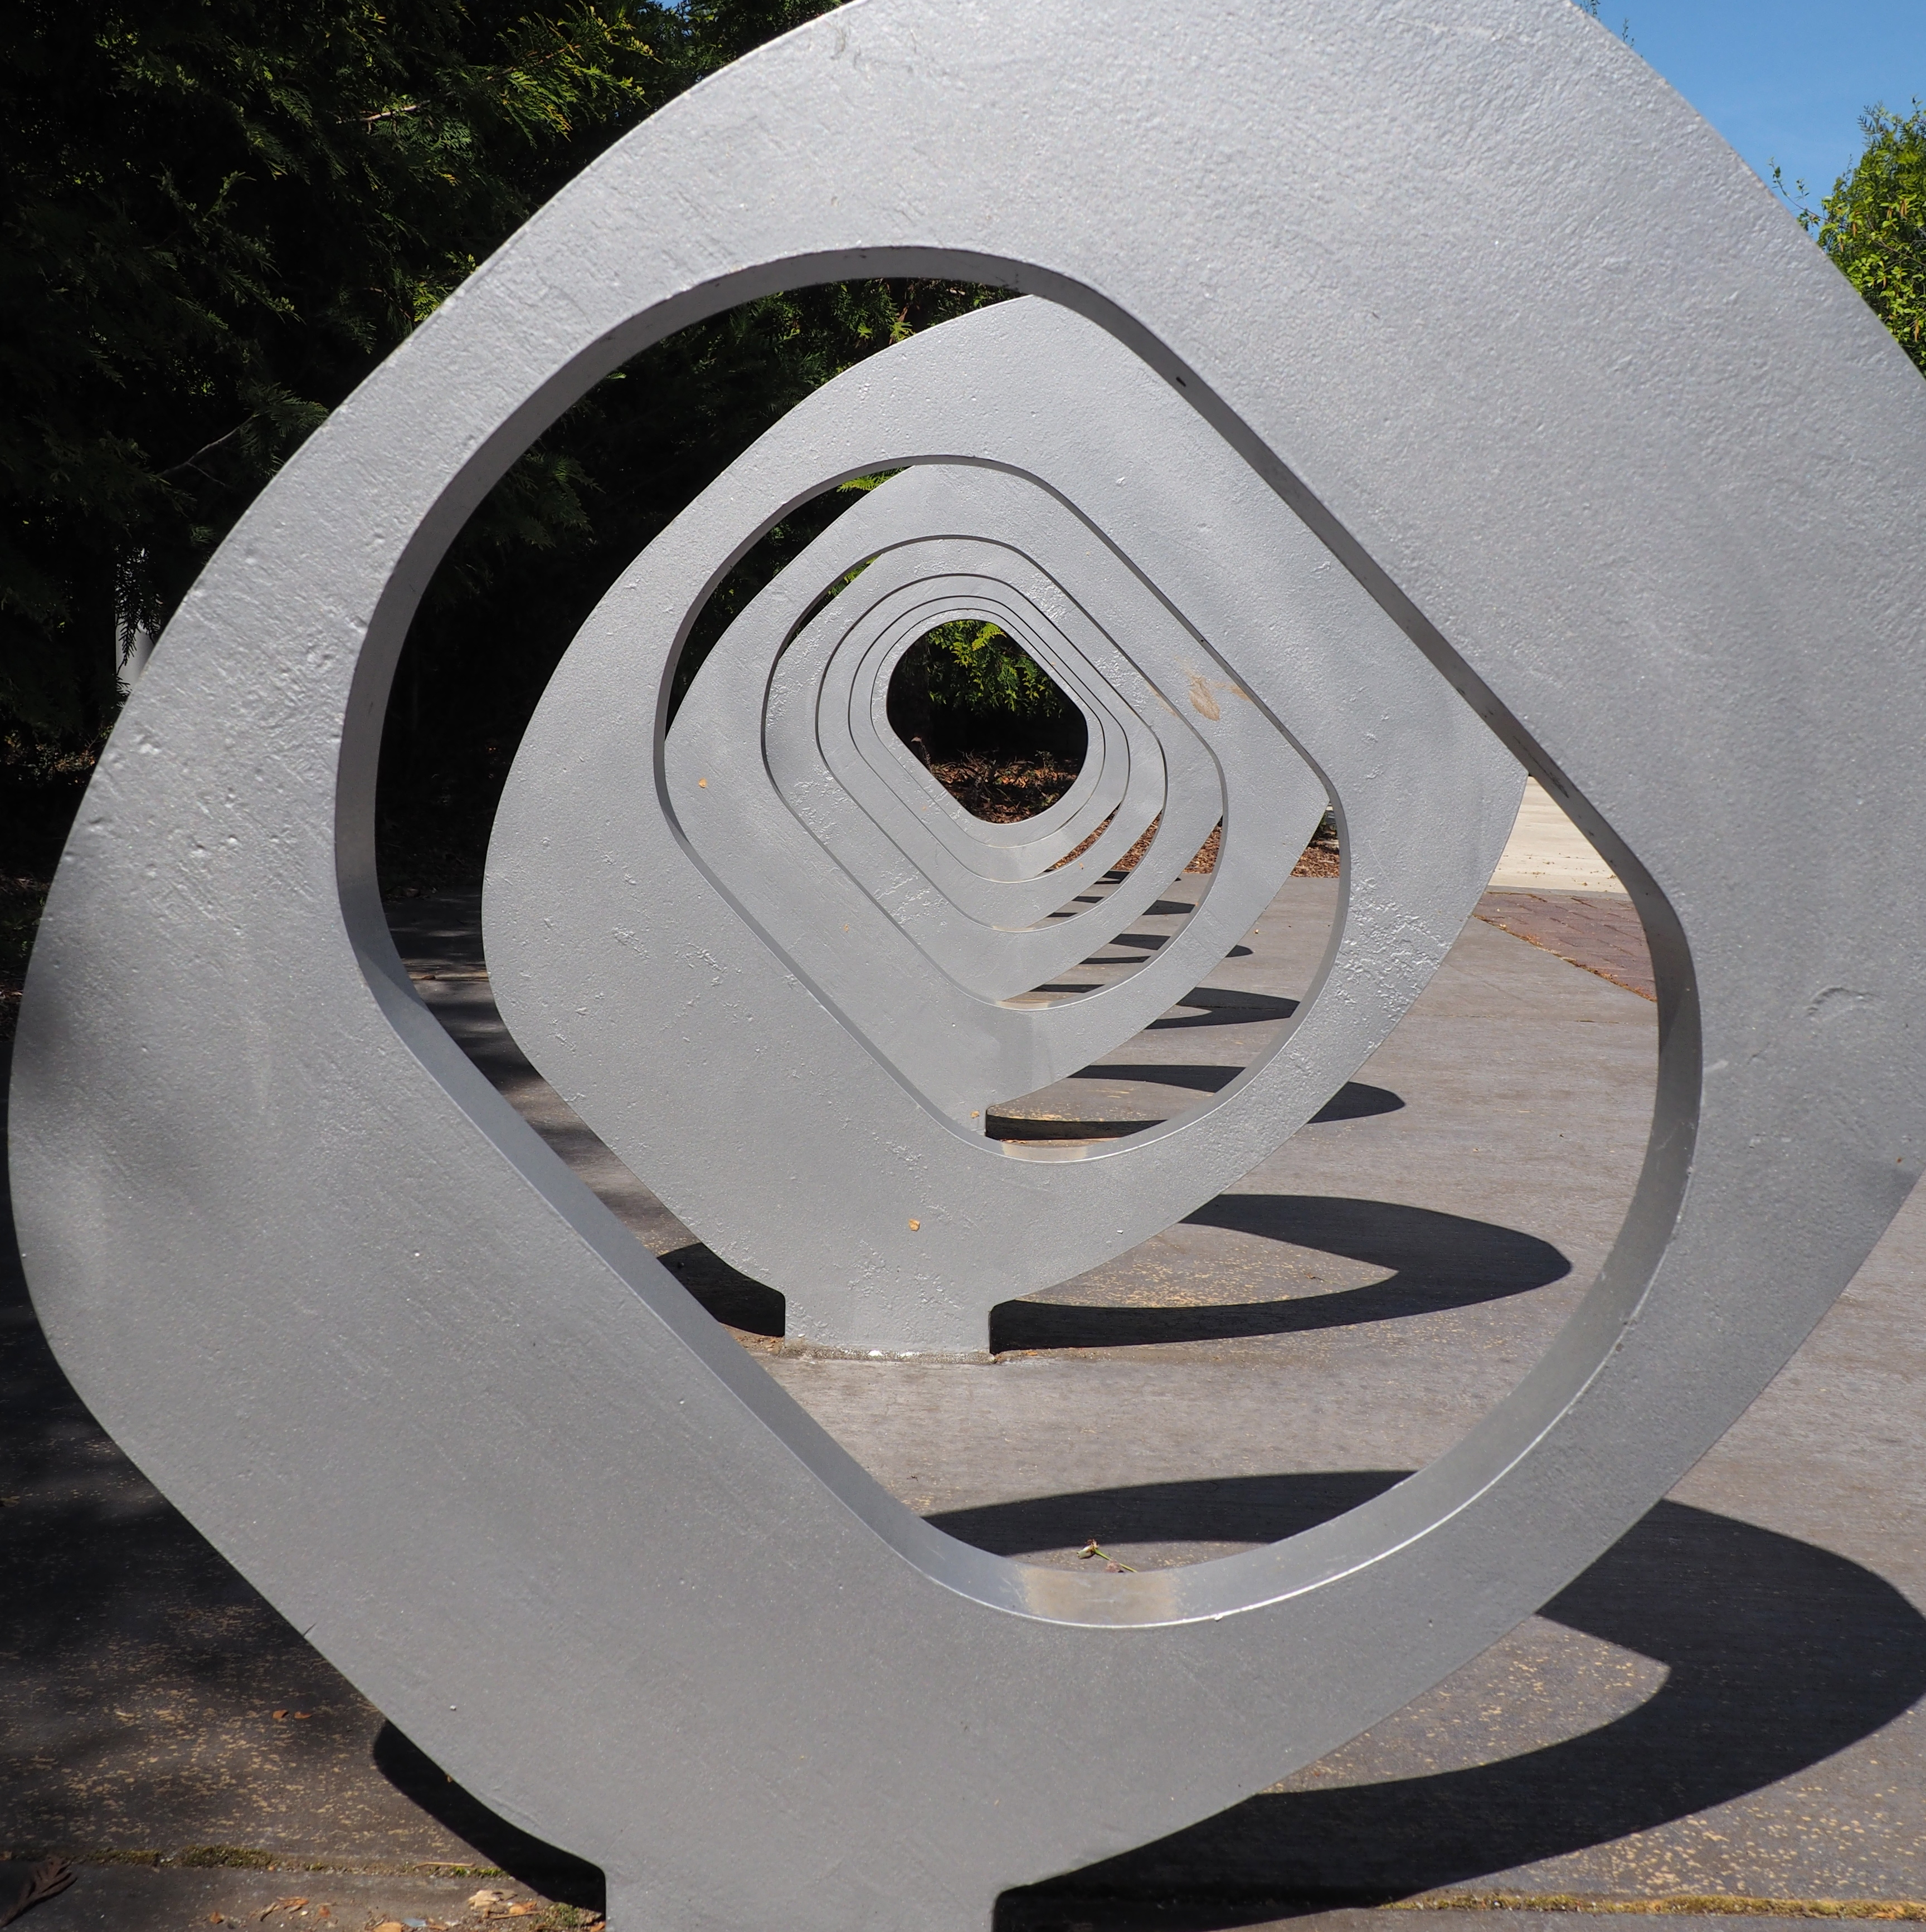
Ethan Mapes
Export Control Officer
Mandy Gettler
Associate Director of Conflicts of Interest & Export Controls
exportcontrols@uoregon.edu
exportcontrols.uoregon.edu

