Slide 1


Fundamentals of the NIH Grant Process &
Need to Know Resources
Fall 2021
Notes:
Welcome to Fundamentals of the NIH Grant Process & Need to Know Resources.

Slide 2
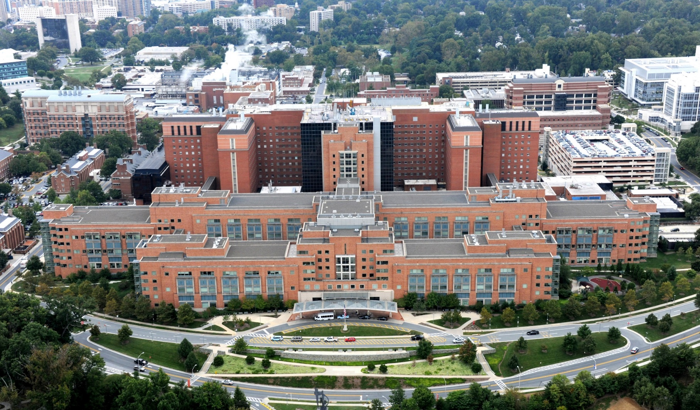
Who We Are
Largest public funder of biomedical research in the world.
Clinical Center (Building 10), NIH Campus
Notes:
NIH is the largest public funder of biomedical research in the world.

Slide 3

NIH Mission
To seek fundamental knowledge about the nature and behavior of living systems and the application of that knowledge to enhance health, lengthen life, and reduce illness and disability.
Notes:
Its mission is to seek fundamental knowledge about the nature and behavior of living systems and the application of that knowledge to enhance health, lengthen life, and reduce illness and disability.

Slide 4
NIH FY2020 By The Numbers
56,169 extramural grant awards totaling $30.761 billion
Supported research at 2,650 organizations
Notes:
In fiscal year 2020 NIH awarded over 56,000 extramural grants totaling more than $30.7 billion in funding. That funding supported research at 2,650 organizations throughout the U.S. and abroad.
All of us together have a shared responsibility for the appropriate stewardship of that tremendous investment.

Slide 5

Questions we’ll cover
Where do I start?
Where’s the funding?
Where do I turn when I need help or advice?
What opportunities are available & how can I find them?
What’s the application process & how long does it take?
Notes:
If you are new to working with NIH, then chances are you’ve asked one, or maybe all, of these questions:
Where do I start?
Where’s the funding?
Where do I turn when I need help or advice?
What opportunities are available and how can I find them?
What’s the application process & how long does it take?
These are precisely the questions we’ll cover and I’ll point out those need-to-know resources along the way.

Slide 6

Where do I start?
Notes:
Where do I start?

Slide 7
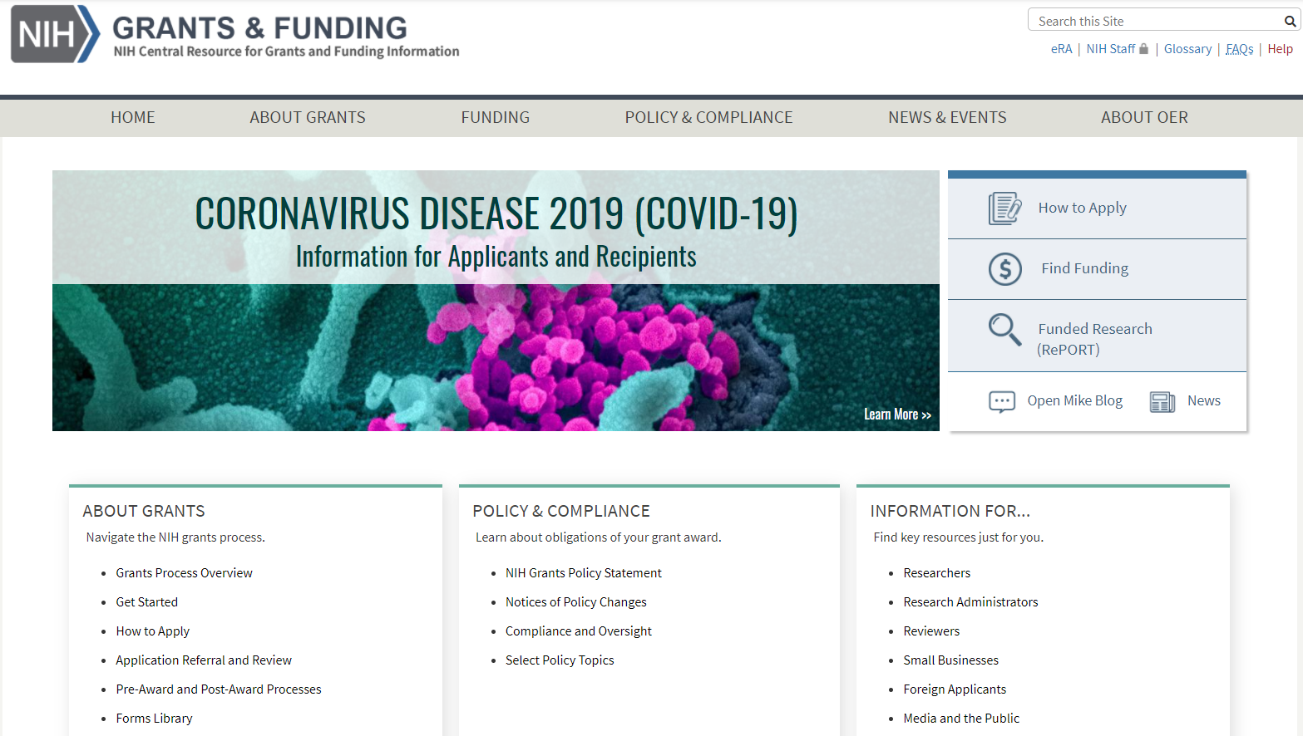
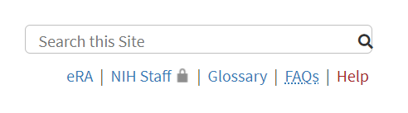
Grants.nih.gov – Utility Links
https://grants.nih.gov
Notes:
You’ll find all you need to know on the NIH Grants & Funding website found at grants.nih.gov.
We have utility links in the upper right corner that remain accessible as you navigate through the site. You’ll find a quick link to our electronic Research Administration or eRA systems page – if you aren’t yet familiar with eRA Commons - the system we use to interact electronically with you – you’ll learn all about it this week. There’s a glossary to help decipher NIH acronyms and terminology. We have hundreds of topic-specific FAQs. And a Help page to identify contacts when the online resources simply aren’t sufficient.

Slide 8
Grants.nih.gov
https://grants.nih.gov
Application Guide
NIH Guide for Grants & Contracts
RePORT Tools
Notes:
The How to Apply Application Guide includes everything you need to know to prepare to apply, complete the application forms, and submit your application.
The NIH Guide for Grans & Contracts is our official publication for NIH grant policies, guidelines, general information, and funding opportunities.
And, our RePORT tools, including RePORTER and Matchmaker, provide access to data and analysis of decades of NIH-funded projects.

Slide 9
Grants.nih.gov
https://grants.nih.gov
General grants process information
Policy & Compliance
Notes:
The site also contains a wealth of general grants process and
policy and compliance information.
We’ll talk more about many of these resources. For now, just be aware that it’s all there.

Slide 10

Questions

Slide 11
Where’s the funding?
Notes:
Where’s the funding?

Slide 12
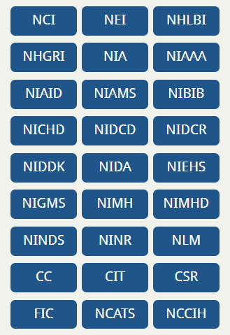
National Institutes of Health
27 Institutes and Centers (ICs)
Each IC has its own
  mission,
  priorities,
  budget, and
  funding strategy.
Related resource … NIH Institutes, Centers, and Offices
Notes:
To answer this question, you need to know a bit about how the National Institutes of Health is structured. NIH is made up of 27 different institutes and centers (or ICs) of which 24 offer funding opportunities and award grants. This is a very important point. NIH funding is made through these institutes and centers.
Each IC has its own mission, priorities, budget, and funding strategy which are stated on each IC’s website.
The vast majority of grant processes and polices apply across NIH. That said, you will find some variability from one IC to the next. .
Do your homework. Identify which ICs might be interested in your area of science. Determine if your proposal fits within that ICs mission and priorities. Find out what has already been funded? By law, NIH can’t support a project already funded or pay for research that’s already been done.
You need to know and be able to articulate what sets your proposal apart.
The overall success rate for competing research grants is around 20%. This is a highly competitive process.

Slide 13
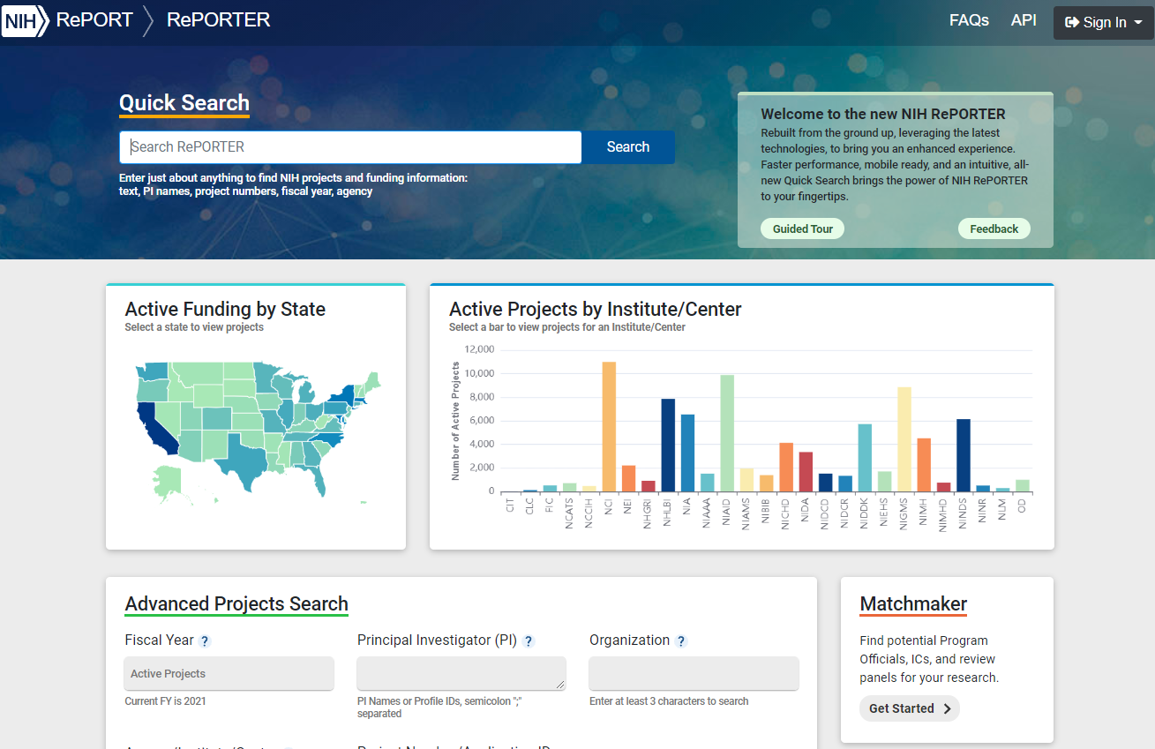
RePORTER
https://reporter.nih.gov
Notes:
Let’s talk about finding that target IC. We have a great tool, called RePORTER that allows you to explore decades of funded awards and can help identify ICs with potential interest in your area.
If you’ve used RePORTER then you already have an idea of the information you can glean from it.
If you’ve never used it, I recommend starting with the Matchmaker tool.

Slide 14
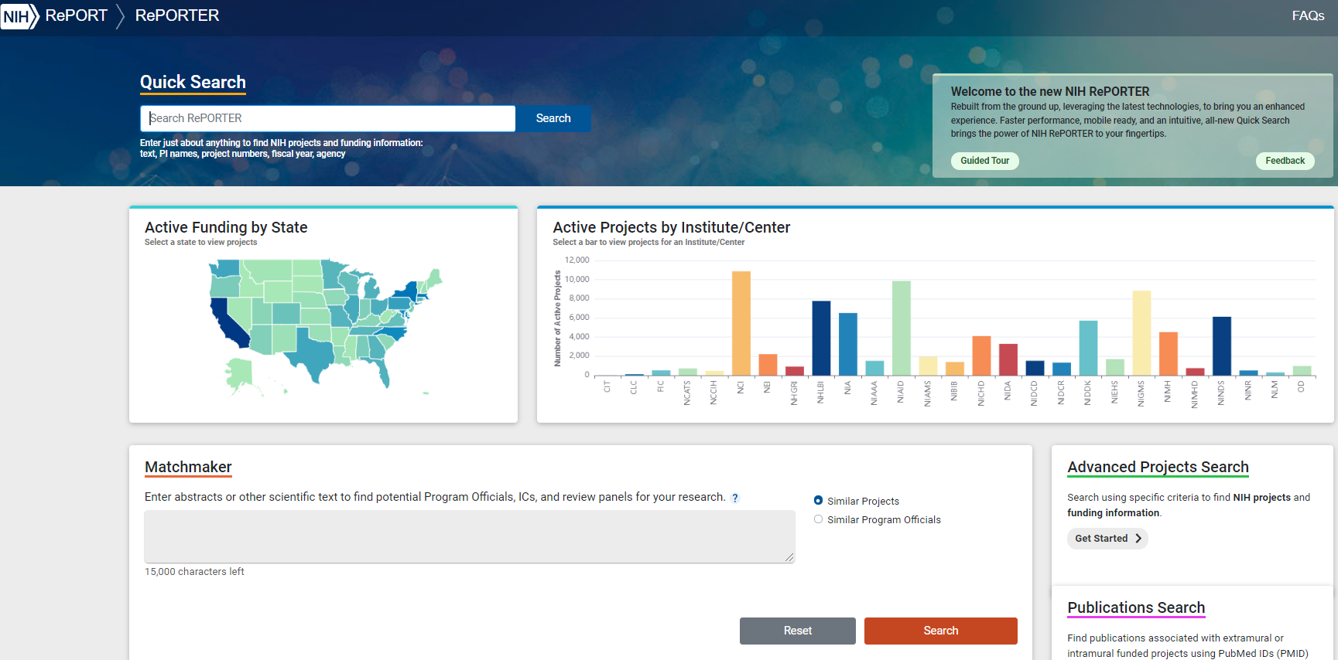
Matchmaker
https://reporter.nih.gov/matchmaker
Notes:
The Matchmaker interface is simply a text box.

Slide 15
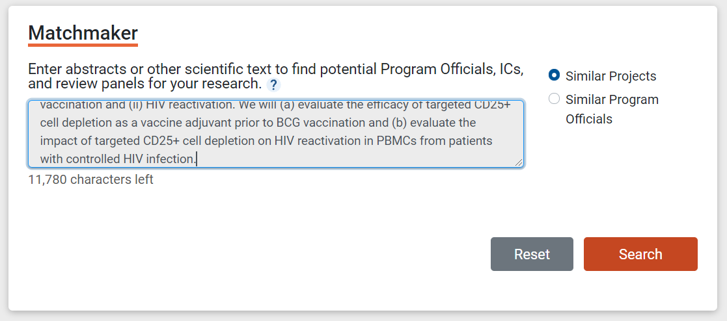
RePORTER - Matchmaker
Notes:
You give Matchmaker up to 15,000 characters of text which you can pull from your abstract, specific aims, or other source that describes your proposed research …

Slide 16
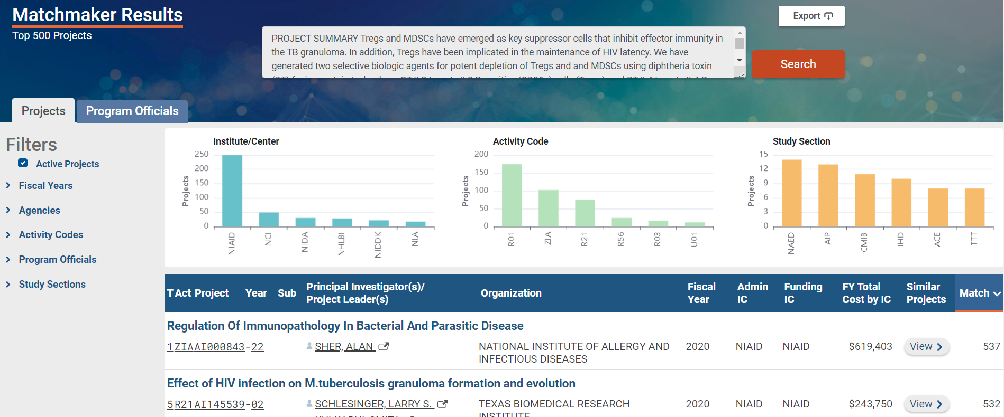
RePORTER – Matchmaker Results
Notes:
… and Matchmaker returns the awarded projects that most closely match that text.
And, the results include graphs along the top for the ICs, activity codes and study sections associated with those projects.

Slide 17
RePORTER – Drilling Down in Results
Notes:
This example clearly has a strong match with NIAD - our National Institute of Allergy and Infectious Diseases. You can click on the NIAD bar in the graph …

Slide 18
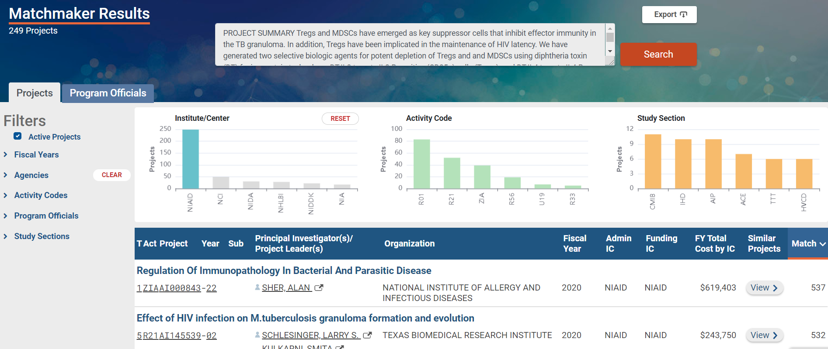
RePORTER – Filtered Results
Notes:
and the results automatically filter to just those projects funded by that IC.
You can drill down into each project and read the abstract and other details to get a feel for what’s been funded.

Slide 19
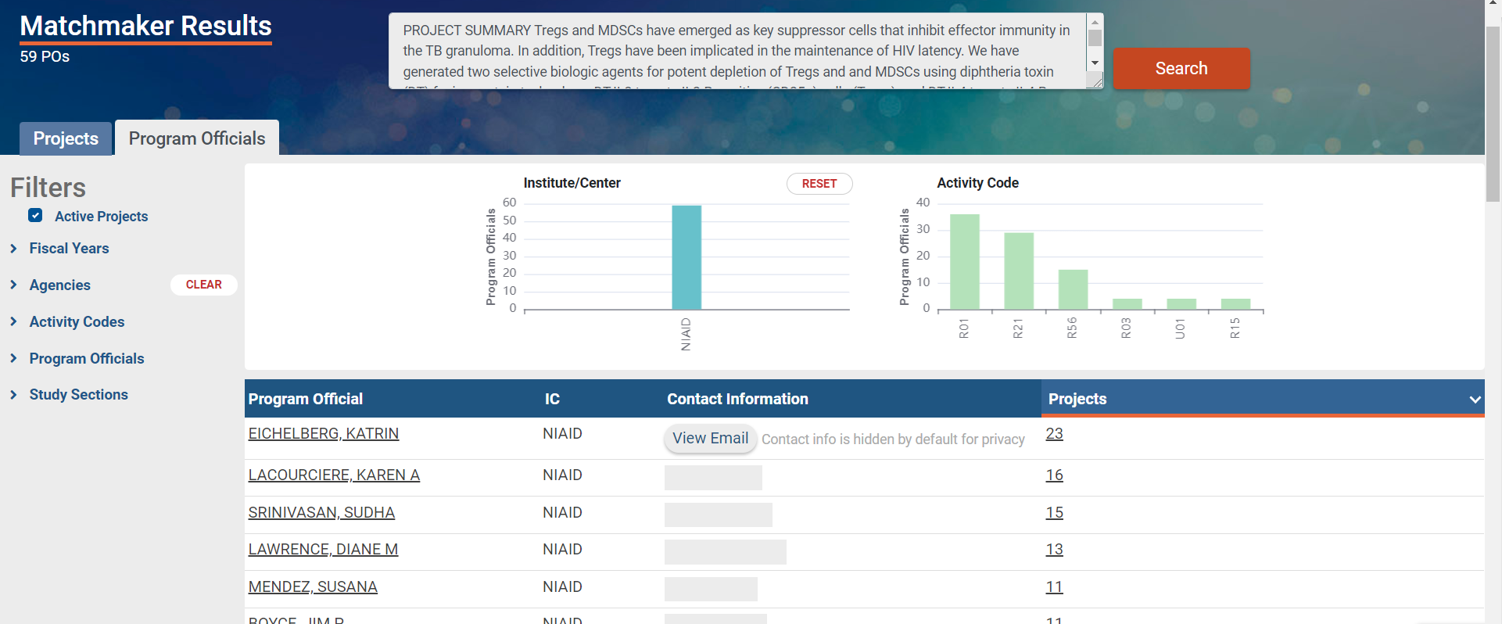
RePORTER – Program Officials
Program Officials
Notes:
And, at the top of the results, you can even move from the Projects tab to the Program Officials tab to get a list of NIH scientific staff whose portfolios include the identified projects.
Using the Matchmaker tool, with just a few queries and clicks, we identified both a potential funding institute and staff contacts.

Slide 20
Questions
Related sessions …
Using RePORT to Understand Who and What NIH Funds – Wednesday, Nov. 3 at 2 PM

Slide 21
Where do I turn when I need help or advice?
Notes:
… where do I turn when I need help or advice?

Slide 22
The NIH Extramural Team
Program Official (PO)
Scientific Review Officer (SRO)
Grants Management Officer (GMO)
Related resource … Understand Staff Roles
Notes:
We just saw one way to identify potential Program Officials using Matchmaker. Program Officials are one of three players in the NIH Extramural Team. The other two are Scientific Review Officers and Grants Management Officers.
Each has a role in the application and award process.

Slide 23
Program Official
Scientific portfolio of awards within the mission of an institute
Initiative development
Provides programmatic, scientific, and/or technical guidance pre-application, submission, and post-review
Recommends applications to be considered for award to the IC director
Post-award oversight by monitoring research progress
Notes:
Provides - Programmatic, scientific, and/or technical guidance pre-application, post-review and post-award

Slide 24
Scientific Review Officer
Responsible for scientific and technical review
  Ensures fair and unbiased evaluation of scientific and technical merit
  Provides a summary of the evaluation
  Reviews applications for completeness and conformance with application requirements
Point of contact for applicants during the review process

Slide 25
Grants Management Officer
Responsible for completion of business management requirements
  Evaluates reviewed applications for administrative content and compliance with policy
  Negotiates and prepares grant Awards
  Post-award oversight by monitoring grant activity
  Interprets grants administration policies

Slide 26
Questions
Related sessions …
Roles, Responsibilities and Partnerships Throughout the Life Cycle – Monday, Nov. 1 at 3 PM

Slide 27
What opportunities are available & how can I find them?
Notes:
Now, let’s look at the available opportunities and how to find them.
So, what opportunities are actually out there and where can I find them?

Slide 28
Funding Opportunity Announcements (FOAs)
Used to advertise grant opportunities
Contain information needed for successful application submission
Related resource … Understand Funding Opportunity Announcements
Notes:
We use funding opportunity announcements, or FOAs, to advertise our grant opportunities.
They contain all the information you need to successfully submit an application.

Slide 29
FOAs Include
Opportunity description
Participating ICs
Key dates
Award information
Eligibility
Submission requirements
Review criteria
Award administration
Agency contacts
Notes:
FOAs include
An opportunity description
A list of participating institutes and centers
Key dates like due dates and expiration date
Award information like whether clinical trials are allowed and any project period or budget limitations.
Eligibility information for both the applicant organization and the designated principal investigators. For my international friends out there, we clearly indicate in this section whether foreign institutions are eligible to apply and any citizenship requirements for the PD/PI.
It includes any opportunity-specific submission requirements
Review criteria
Award administration information
And, scientific/research (think program), peer review, and financial/grants management contacts within the participating ICs.

Slide 30
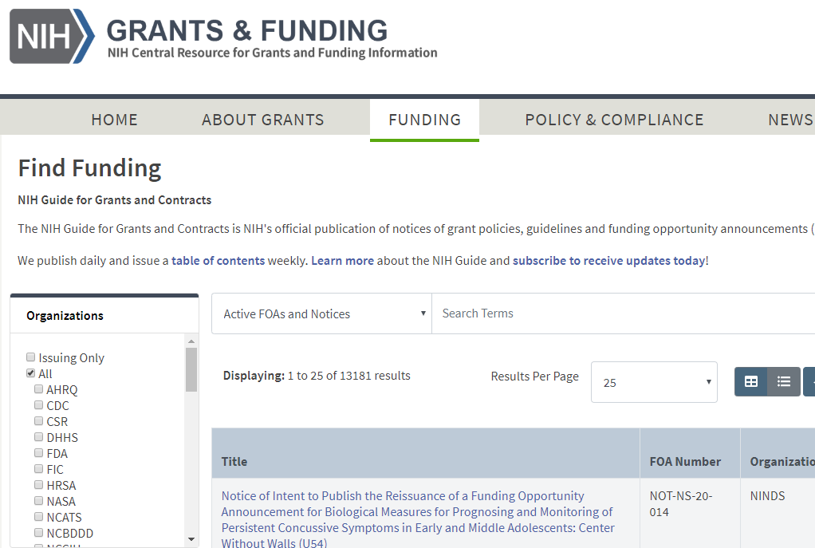
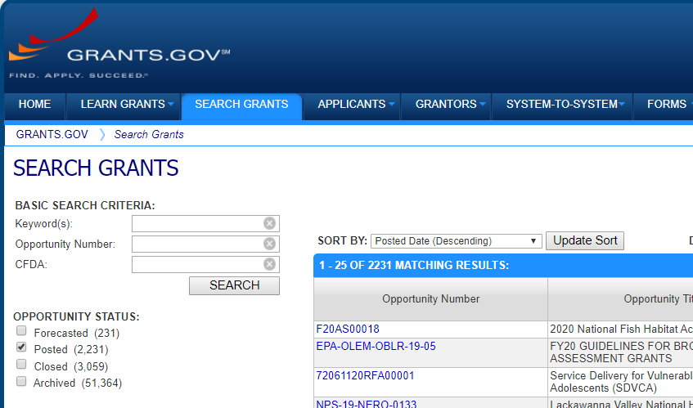
Find Opportunity of Interest
NIH Guide for Grants & Contracts
Grants.gov
Notes:
You can find all NIH opportunities in the NIH Guide for Grants & Contracts – remember that “Find Funding” link on our Grants page. And at Grants.gov which is the federal-wide portal for all grant making agencies.
You can also find subsets of our opportunities on our program specific pages like our small business page and on IC websites.
Both the NIH Guide and Grants.gov have robust search capabilities and I recommend searching both sites.

Slide 31
Grants.gov
FOAs for all federal grant-making agencies
Related resource … Grants.gov Search Grants
Notes:
Since Grants.gov is federal-wide, you may find opportunities at other agencies you won’t find in the Guide.

Slide 32
NIH Guide
FOAs
Notices
  Notices of special interest
  Policy updates
  Changes to FOAs
  Webinars and training events
Related resource … NIH Guide
Notes:
In the NIH Guide, in addition to the FOAs advertised in Grants.gov, you’ll also find notices, including
Notices of special interest
Policy updates
Changes to FOAs
Webinars, training events
And more
I also recommend subscribing to our weekly emails that summarize the NIH Guide postings for the week. You’ll find the links to subscribe to our listservs under the News and Events tab on the grants site.

Slide 33
NIH Funding Opportunities
FOA Types
  Requests for Applications (RFAs)
  Parent Announcements
  Program Announcements (PAs)
Notices of Special Interest (NOSIs)
Notes:
We post several types of FOAs
Requests for Applications or RFAs,
Parent Announcements, and
Program Announcements or PAs.
We also use notices of special interest to highlight research areas of interest.

Slide 34
Requests for Applications (RFAs)
Narrowly defined scope
Set-aside funds
Often a single receipt date
Notes:
Requests for Applications have a narrowly defined scope and the participating IC or ICs set aside funds in their budgets to award applications. The award information section of the FOA indicates the number of expected awards and/or the amount of set-aside funding.
RFAs often have a single receipt date and may not be posted again.

Slide 35
Parent Announcements
Many NIH institutes and centers participate
No science specified
For “investigator initiated” or “unsolicited” research
Use standard due dates
Related resource … Standard Due Dates
Notes:
Many ICs participate in our parent announcements which are used for investigator initiated or unsolicited research.
They don’t specify a particular area of research. They simply provide the infrastructure and information needed to submit a research proposal that fits within the missions of a participating ICs.
They use a standard due date schedule that defines three submission, review, and award cycles per year. They are posted for up to 3 years and are then reissued.

Slide 36
Program Announcement (PA)
Highlights areas of focus
Usually ongoing (3 yrs)
Use standard receipt dates
Special types
  PAR – PA with special receipt, referral or review considerations
  PAS – PA with set-aside funds
Notes:
Unlike the parent announcements, our program announcements or PAs highlight areas of focus.
They are typically on-going programs posted in increments of up to 3 yrs.
They use the same standard due date schedule as parent announcements, unless they are identified as a PAR – a program announcement with special receipt, referral or review considerations.
Applications to parent announcements and program announcements all compete for the same funding. They don’t have set-aside funds, unless they are identified as a PAS – which is a program announcement with set-aside funds.
Let’s pause for a second. As you work with NIH, you will hear the words “except”, “unless” and my personal favorite “it depends” a lot.
With so many funding organizations covering a broad range of topics, its not surprising that NIH processes are filled with nuances. Read the announcement carefully and reach out if you have questions.

Slide 37
Notices of Special Interest (NOSIs)
Increasingly used instead of program announcements
Highlight areas of scientific interest
Designate existing FOAs to use for application submission
Related resource … Notices of Special Interest – Video (5 min)
Notes:
It takes many months and lots of resources to get a full FOA approved and posted. We found that many of our program announcements were nearly identical except for highlighting a specific area of scientific interest or initiative. Notices of Special Interest or NOSIs provide that unique information in a succinct notice and leverage existing FOAs, such as parent announcements, to receive applications.

Slide 38
Types of Grant Programs
Research Grants (R series)
Career Development Awards (K series)
Institutional Research Training & Individual Fellowships (T & F)
Program Project/Center Grants (P series)
Resource Grants (various series)
E.g., R01, R03, R21, R15
E.g., K01
E.g., T32, F30
E.g., P01
Related resource … Types of Grant Programs
Notes:
Our FOAs cover a wide range of grant programs, including
Research,
Career development,
Training,
Fellowship,
Program Project and Center grants, and
Resource grants.
We identify these programs through the use of 3-character codes we call activity codes. For example, we use the R series for research grants and we have activity codes like R01, R03, R15,and many others.
K01 is an example of a career development activity code in our K series. T32 an example of training code. F30 an example of a fellowship code. And, P01 an example of a Program Project code.

Slide 39
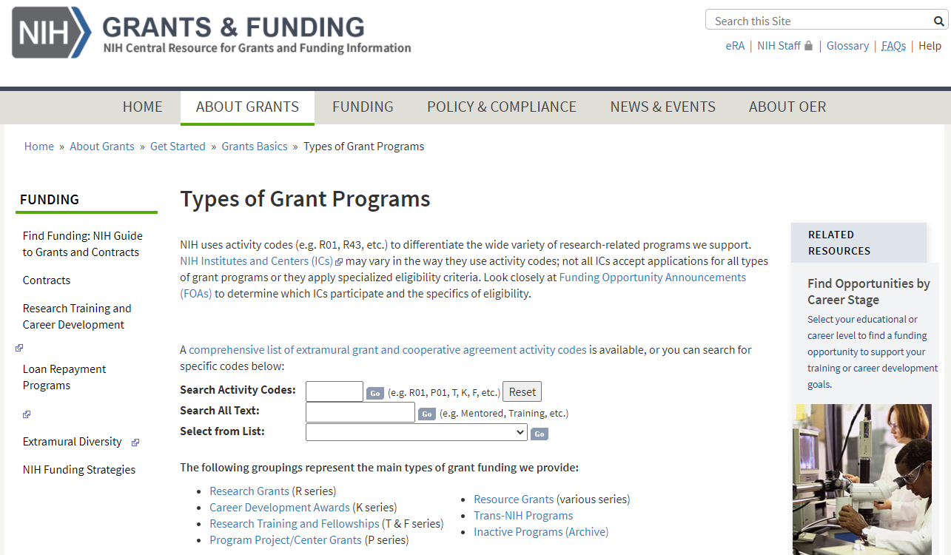
Types of Grant Programs
Notes:
You can learn about these activity codes on our Types of Grant Programs page.
On the far right of the page there’s a link to a handy site that helps match programs and career stage from undergrad through to established investigator.

Slide 40
Questions
Related sessions …
Navigating NIH Programs: An Overview – Monday, Nov. 4 at 4 PM
After-Hours Conversation: Planning Your Career Path: NIH Experts Share Their Perspectives – Monday, Nov. 4 at 5 PM
Related on-demand videos …
Finding and Understanding Funding Opportunities (12:35)
NIH Grants Administration Take 5: Notices of Special Interest (4:59)

Slide 41
What’s the application process & how long does it take?
Notes:
We’ve talked about identifying your target IC, available programs, and finding an FOA or NOSI that’s a good fit. Which brings us to our next question – What’s the application process and how long does it take?

Slide 42
Grants Process Overview
Grants Process Overview
Related resource … Grants Process Overview
Notes:
You’ll find a Grants Process Overview on the grants.nih.gov site.

Slide 43
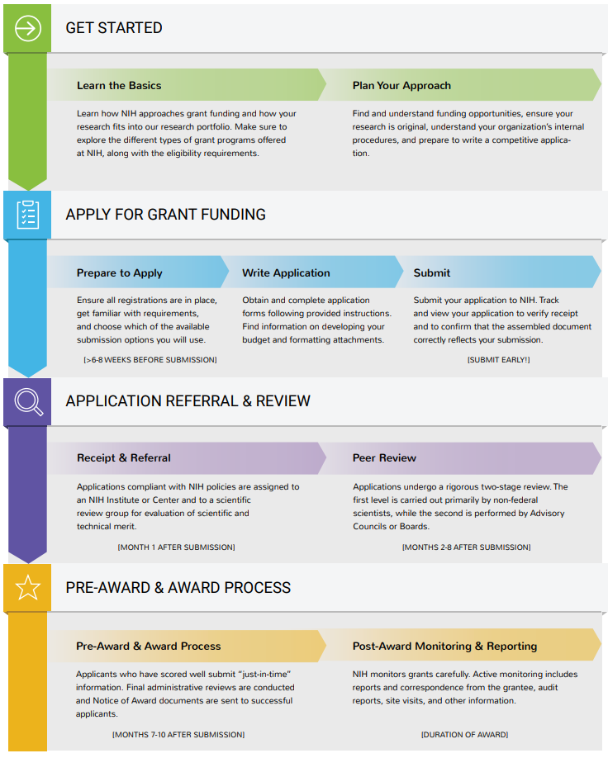
Grant Process Overview
Notes:
It takes you through the process from getting started, to applying for funding, to application referral & review, and finally the pre-award & award process.
You can click on each topic in the graphic to learn more about each step. But, I’ll walk you through the key points and help you get a feel for the timeline.

Slide 44

Plan
6+ months prior to due date
Refine your research idea
Reach out to NIH staff
Build your team & internal plan
Notes:
It takes about 9 months from the submission to an application becoming a grant. How much time does it take to prepare a competitive application?
We’ll start with planning. At least 6 months prior to your target due date you should be well on your way to refining your research idea.
Reach out to NIH staff. Discuss your proposal. Make sure it fits within the IC mission and priorities.
We talked about the NIH team of program officials, grants management officers and scientific review officers. You’ll also need a team within your own organization and a plan to coordinate that team.

Slide 45
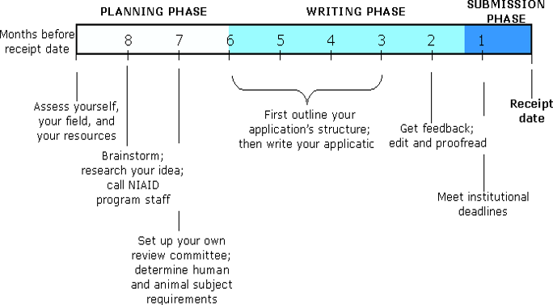
How much time does it take to write a grant application?
It varies, but two weeks before the receipt date is not enough.

Slide 46

Your Team
Members
  Authorized Organization
  Official (AOR)/ Signing Official (SO)
  Project Directors/Principal Investigators (PD/PI)
  Others
Discuss roles, process & timelines
Notes:
NIH awards grants to organizations, not to individual investigators. So, right of the bat, your team includes an Authorized Organization Representative or AORs (we refer to them as signing officials in eRA Commons). The AOR is responsible for submitting the application and it’s their electronic signature that is signing off on the terms and conditions of the grant on behalf of the applicant organization.
Of course you’ll have one or more Project Director/Principal Investigators responsible for directing the supported project or program. You’ll hear them referred to as PD/PIs or PIs.
You may also have additional senior/key individuals, administrative staff, or collaborators. You’ll want to identify some colleagues to review your application and provide feedback. And, if they have grant or review experience, even better.
Once you have your team in place make sure everyone knows their role, the process that will be followed, and your timeline.
Establish that plan upfront.

Slide 47

Prepare to Apply
Confirm registrations
  6+ weeks to complete
Confirm funding opportunity
Identify submission method
Include the institutional timeline in your plans
Notes:
You’re then ready to prepare to apply. If your organization has never submitted a grant application before, you’ll need to get started on multiple organization registrations, including the System for Award Management, Grants.gov and eRA Commons. It can take 6 or more weeks to complete the organization registrations, so don’t wait to get that started.
Contact your Office of Sponsored research. Get to know their schedule for submitting a grant application. You can't submit the application without their cooperation. If your organization has submitted previously, make sure all registrations are current and active. The System for Award Management requires annual renewal. You can’t submit unless its active.
Confirm your funding opportunity. NIH posts opportunities 30-60 days prior to the first due date. You may find a newly published opportunity that is an even better fit than the one you originally chose. You’ll also want to check the Related Notices section of the opportunity for any late breaking changes or corrections.
And you must identify the submission method you will use to prepare and submit your application.

Slide 48




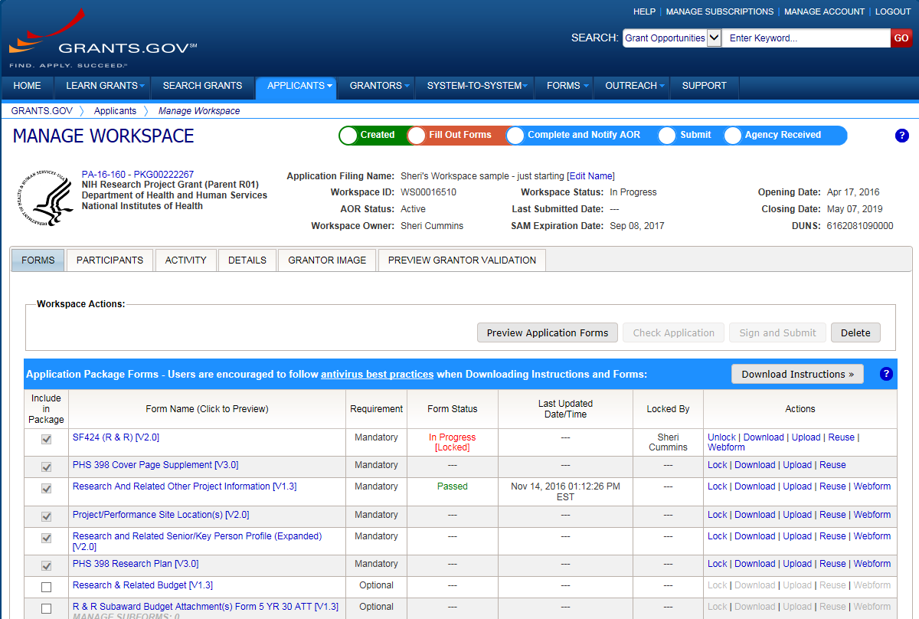



Application Submission Options
Access & prepare application forms using one of these submission options.
ASSIST
System-to-System
Workspace
Related resource … Submission Options
Notes:
Grant application forms must be prepared and submitted using NIH’s ASSIST, Grants.gov’s Workspace, or your institution may have its own system-to-system solution. Your office of sponsored research can help identify the best option for your situation.
Honestly, it doesn’t matter which option you choose.
Your application will flow through the Grants.gov federal portal and then on to eRA Commons - which is our system to exchange information electronically with our applicants and grantees.
Since all application follow that same flow, they’re all subject to the same
Registrations
Business rule validations
And, are assembled into a consistent format for funding consideration.
By the time the applications are seen by NIH staff we can’t even tell which system was used to submit them.

Slide 49
Write Application
Complete application forms and attachments
Write strong proposal that addresses review criteria
Read & follow all instructions
Related resource … Write Your Application
Notes:
You’ll login to your submission option, provide the funding opportunity number, and you’ll be presented with the exact set of forms needed to write your application.
Much of the really good stuff in your application - your abstract, specific aims, research strategy, biosketches and more - will be in attachments which are uploaded in pdf format into specific form fields. All of these critical pieces of your proposal can be started well in advance of pulling together the application forms.
Write a strong proposal that addresses the review criteria in the opportunity. See the session on grant application writing.
Most importantly, read and follow all instructions.

Slide 50
How to Apply – Application Guide
How to Apply – Application Guide
How to Apply – Application Guide
https://grants.nih.gov/grants/how-to-apply-application-guide.html
Notes:
Our How to Apply – Application Guide, which is easily found on our grants page and linked within every opportunity, contains your general application instructions.

Slide 51
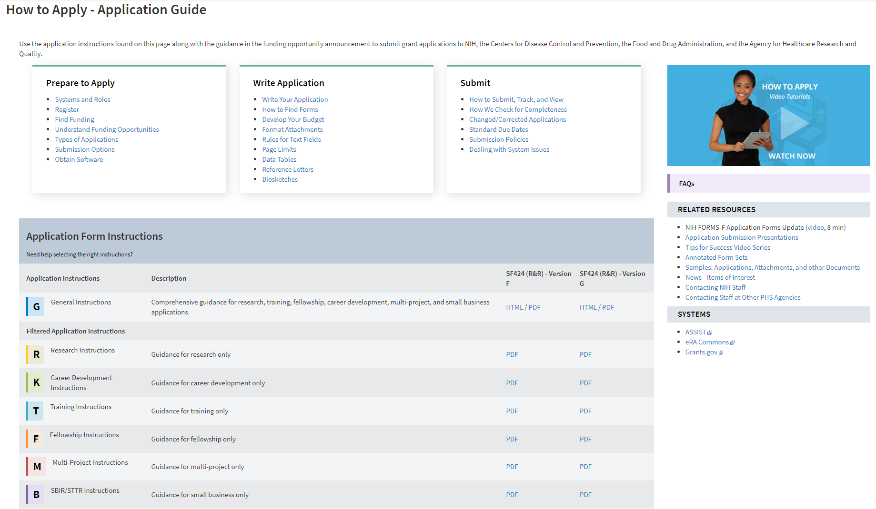
How to Apply Application Guide home page
Notes:
On the How to Apply – Application Guide page you’ll find sections for Prepare to Apply, Write Application, and Submit. Here are a few highlights.
In the Prepare to Apply section you’ll find details on the organization and individual registrations needed to apply. Understand Funding Opportunities talks about the different types of announcements – RFAs, PAs, parent announcements and NOSIs. Types of Applications explains the difference between new, revision, renewal, and resubmission applications. And, you can learn about ASSIST, Workspace and system-to-system solutions under Submission Options.
Write Application includes some great information on developing your budget. Remember I said much of your proposal is in pdf attachments. The Format Attachments page describes our rules for fonts, margins, filenames, images, links and more. Many of the attachments have strict page limits all applicants must follow for fairness. There is a link to our standard page limits table and any exceptions would be noted in your FOA or NOSI.
Under Submit we explain the process for submitting and tracking your application and how we validate your application using a combination of system and manual checks. There’s a link to the standard due dates we talked about earlier. A link to Submission Policies that explain what happens if your due date falls on a weekend or holiday or when Washington area government offices are closed, or your institution is closed due to weather or natural disaster. And finally what to do if a problem with a government system impacts your ability to submit your application on time.
We have videos, FAQs, resources, and most importantly form-by-form, field-by-field instructions for completing your application forms.

Slide 52
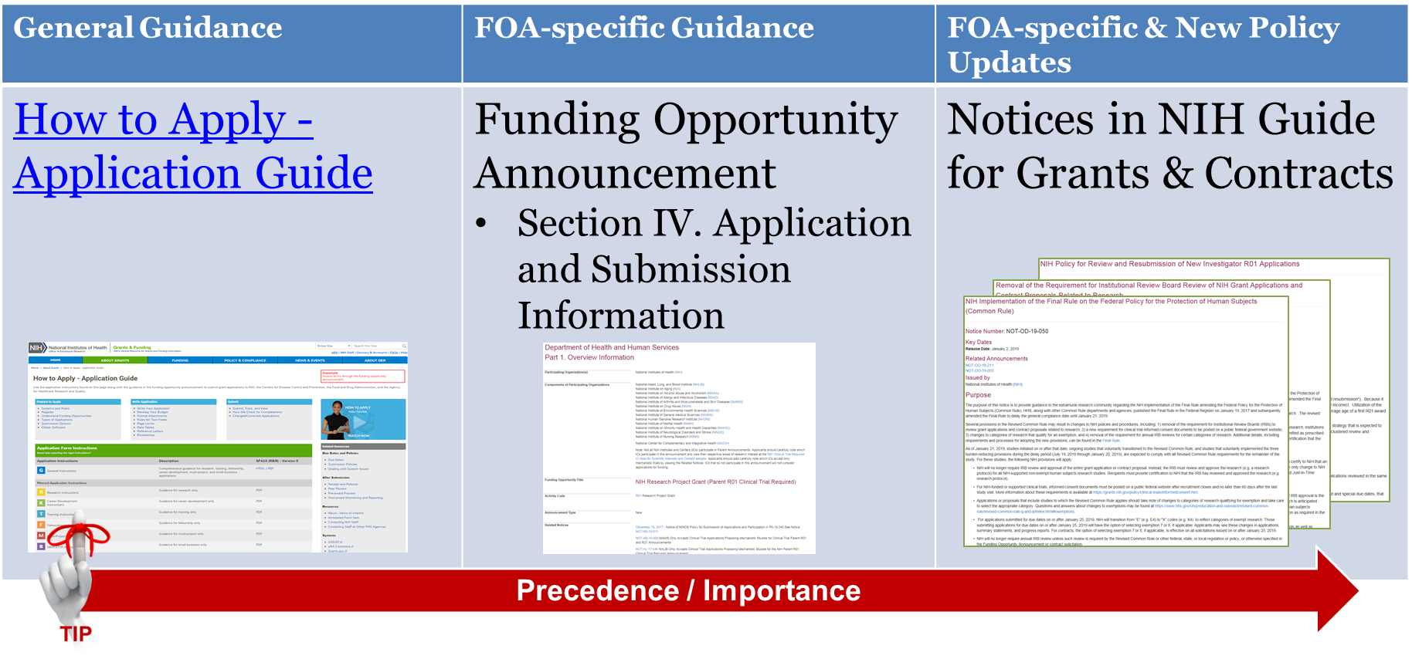
Follow All Instructions Carefully
Notes:
Remember the first three rules about applying for a grant. You must read and follow all instructions. Then Read and Follow All Instructions. Then read and follow all instructions.
The application guide provides general instructions and the FOA provides opportunity-specific instructions that augment or may even differ from the application guide. So, when completing your application forms you’ll follow the application guide unless the FOA tells you to do something different.
Many of our opportunities are active for up to 3 years. We can change a lot of policies in 3 years. And, from time to time, we make mistakes and need to post corrective notices for an opportunity. NIH Guide Notices win over both the FOA and general application guide instructions.

Slide 53
Submit Early!
Applications routed through Grants.gov to NIH’s eRA Commons
Days before due date
  Allow time to check application image in eRA Commons and address any unforeseen issues
Related resource … How to Submit, Track and View Your Application
Notes:
You’ve followed all the guidance and written a strong proposal. You’re checking off items in your internal plan. You’ve reviewed the application internally and its in the hands of your Authorized Organization Representative ready to submit. Your institution submits the application on your behalf. That's why you need to know their schedule. They are there to help you but you need to know how.
Applications are due at 5pm local time of the submitting organization on the date specified in the opportunity.
After you submit your application, it flows through Grants.gov and then on to NIH’s eRA Commons. Track your application. If errors are identified at Grants.gov or eRA Commons, your application will not complete the submission process. If free of system-identified errors, however, the system will assemble all your forms and application attachments into a consolidated document in a consistent format with headers, footers, a table of contents and bookmarks and place it in eRA Commons. From this point forward, you will continue to use eRA Commons from checking status of your application to closeout of an awarded grant.
Submit early! When we say “early” we mean days, not hours or minutes ahead of the deadline. This gives you time to address unforeseen issues and thoroughly check that final assembled application image in eRA Commons. That assembled eApplication is the same document that will be used by reviewers and staff for funding consideration. It’s your responsibility to check it in eRA Commons and notify us of any assembly issues within the 2 days following the submission.

Slide 54

Receipt & Referral
Additional application checks
Application Number assigned
IC assignment
Assignment to Integrated Review Group (IRG)
  IRG Chief assigns study section
Assignment details placed in eRA Commons (~2 weeks)
It's all on your Commons Page
Related resource … Submission & Assignment
Notes:
What happens at NIH after you submit your application on time?
After the 2-business day viewing window, your application automatically moves on to our receipt and referral staff.
NIH referral staff conduct additional application checks, then assign an application number, a potential funding institute, and an Integrated Review Group or IRG. An IRG is a cluster of scientifically related study sections. An IRG chief assigns the applications to specific study sections for review. Assignment details show in eRA Commons in about 2 weeks, which you can access to learn the application status.
NIH staff conduct additional application checks, then assign an application number, a potential funding institute, and a review group to your application. Within about 2 weeks the assignment details will show in eRA Commons.

Slide 55
Peer Review
Key contact – SRO
Study section reviews for scientific merit
Priority score & percentile ranking in eRA Commons (2-3 days after meeting)
Summary statement in eRA Commons (~1 month)
Related resource … Initial Review, Results, and Appeals
Notes:
Once your application has been submitted it is in the Peer Review stage and the Scientific Review Officer is your key contact and will be listed on the application’s eRA Commons status page. The SRO manages the initial peer review. Reviewers are selected. Applications assigned for review. The study section meets and assesses the applications against the review criteria in the FOAs. The priority scores and percentile rankings are available in eRA Commons 2-3 days after the meeting. It takes a bit longer for the SRO to prepare the Summary Statements which document the official outcome of the review, but many are available in eRA Commons within about a month.
Now, that’s clearly an oversimplification of the peer review process. You’ll find lots more information including full videos on the grants.nih.gov and Center for Scientific Review websites.

Slide 56

Post-Review, Pre-Award & Award Process
Key contacts – PO & GMO/GMS
IC review
Just-in-time information may be requested
Related resource … Pre-Award and Award Process
Notes:
Once the Summary Statement is released, the Program Official becomes your key contact. They can help clarify points made in the summary statement though they can’t discuss details of the review beyond what’s covered in the summary statement. If your application didn’t receive a favorable score, they can provide advice on next steps.
During the pre-award and award process and on through the life-cycle of a grant, the program officer and the grants management officer or specialist work together much like the administrators and researchers in your own organization. The PO handles scientific and programmatic aspects of a project and the grants management officer or specialist handles the business and administrative aspects of the award.
If you receive a score that is broadly in the competitive range, you may be asked to submit additional information through the just-in-time function in eRA Commons. This would be stuff like other support and additional human subjects and animal welfare information. The just-in-time request is not an indicator of award, but the information requested would need to be in place prior to making an award if chosen for funding. So, it behooves you to submit the information when requested.

Slide 57
Pre-Award &
Award Process
Council – funding recommendations
IC Director – funding decisions
Notice of Award (~9 months)
Or Try again
Notes:
NIH uses a 2-level peer review process. Level 1 is that initial scientific peer review. Level 2 is what we call Council. Council procedures can vary across ICs, but each IC Director chairs a National Advisory Council for their IC. The Council recommends applications for funding, but the IC Director makes final funding decisions.
If your application is selected for award, you will receive a Notice of Award or NoA which is viewable in eRA Commons. It takes about 9 months from the submission due date to receiving that notice of award.

Slide 58
Notice of Award (NoA)
Legally binding document
  Award data and fiscal information
  Grant payment information
  Terms and conditions of award
Grantee accepts terms and conditions of award as soon as funds are drawn down
Notes:
The NoA is a legally binding document. It includes award data, payment information, and the terms and conditions of the award. When the grantee organization draws down funds, it is considered an acceptance of the award and associated terms and conditions.

Slide 59

NIH Grants Policy Statement
Term and condition of grant awards
Explicitly defines roles, responsibilities
Updated each fall
Related resource … NIH Grants Policy Statement
Notes:
Those terms and conditions are documented in the NIH Grants Policy Statement or GPS. The Grants Policy Statement is updated each fall and details all the rules, responsibilities and expectations for appropriate stewardship of a grant throughout its life cycle.

Slide 60
Post-Award Monitoring & Reporting
Reports on research progress
Prior approval requests
Audits
Site visits
Related resource … Post-Award Monitoring and Reporting
Notes:
Grantees are responsible for managing the day-to-day operations of their grants. NIH monitors grants carefully. Active monitoring includes reports and correspondence from the grantee, audit reports, and site visits.

Slide 61
Questions
Related sessions … all of them!

Slide 62

Stay Connected
Notes:
One final thought

Slide 63
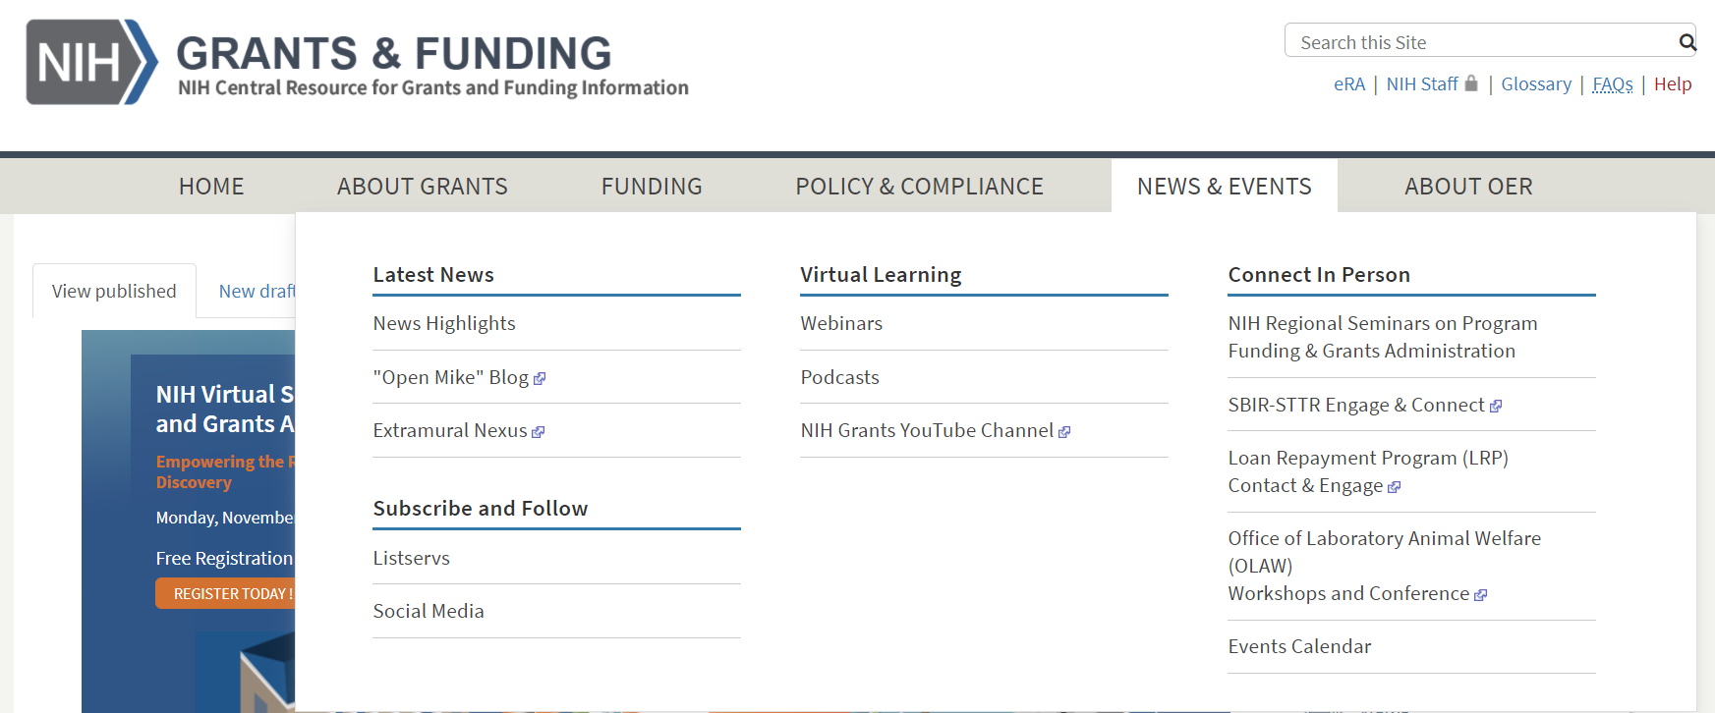
Stay Connected – News & Events
Notes:
Check out the News & Events section of our website to stay on top of what’s happening. It has links to our “Open Mike” blog, NIH Extramural Nexus newsletter, listservs, YouTube channel, podcasts, and social media.
Change is a constant. It’s important to keep informed.

Slide 64

Consolidated Resource List
Notes:
One final thought

Slide 65

Resources: General
NIH Grants and Funding
https://grants.nih.gov/grants/oer.htm
NIH Grants Policy Statement
https://grants.nih.gov/policy/nihgps/index.htm

Slide 66
Resources: ICs & Staff
NIH Institutes, Centers, and Offices
https://www.nih.gov/institutes-nih/list-nih-institutes-centers-offices
Understand Staff Roles
https://grants.nih.gov/help/ic-staff-roles
Grants & Funding – Need Help?
https://grants.nih.gov/help

Slide 67
Resources: Funding Opportunities & Programs
Understand Funding Opportunity Announcements
https://grants.nih.gov/grants/how-to-apply-application-guide/prepare-to-apply-and-register/understand-funding-opportunities.htm
NIH Guide for Grants & Contracts
https://grants.nih.gov/searchGuide/
Grants.gov Search Grants
https://www.grants.gov/web/grants/search-grants.html
Types of Grant Programs
https://grants.nih.gov/Grants/funding/funding_program.htm

Slide 68
Resources: Application Preparation
How to Apply – Application Guide
https://grants.nih.gov/grants/how-to-apply-application-guide.htm
Submission Options
https://grants.nih.gov/grants/how-to-apply-application-guide/prepare-to-apply-and-register/submission-options.htm
Write Your Application
https://grants.nih.gov/grants/how-to-apply-application-guide/format-and-write/write-your-application.htm
Standard Due Dates
https://grants.nih.gov/grants/how-to-apply-application-guide/due-dates-and-submission-policies/due-dates.htm

Slide 69
Resources: Application Process
Grants Process Overview
https://grants.nih.gov/grants/grants_process.htm
How to Submit Track and View Your Application
https://grants.nih.gov/grants/how-to-apply-application-guide/submission-process/submit-track-view.htm
Submission & Assignment
https://public.csr.nih.gov/ForApplicants/SubmissionAndAssignment
Initial Review, Results, and Appeals
https://public.csr.nih.gov/ForApplicants/InitialReviewResultsAndAppeals
Pre-Award and Award
https://grants.nih.gov/grants/pre-award-process.htm
Post-Award Monitoring and Reporting
https://grants.nih.gov/grants/post-award-monitoring-and-reporting.htm

Slide 70
Resources: Tools
RePORTER
https://reporter.nih.gov/
Matchmaker
https://reporter.nih.gov/matchmaker

Slide 71
Thank you!
Notes:
Phew! We covered a lot, didn’t we? That’s the end of the formal presentation.

